Slide 1
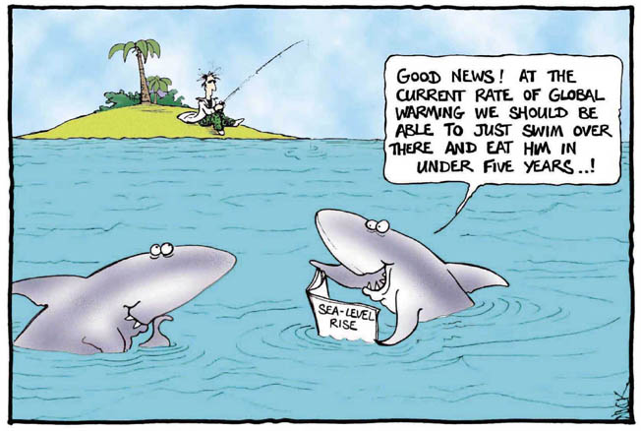
What causes this?
Notes:
Harder

Slide 2
YOUR TASK
Your task in this lesson is to make a poster showing the causes of climate change and the effects it is having on the earth
Use the internet links provided and the success criteria to guide what you do. You should start researching the poster in today’s lesson and complete the poster as our homework for next Wednesday
Grade | What to do
D | List the main greenhouse gases and pollutant gases and where they come from
C | Describe the problems caused by these gases including global warming and acid rain
B | Explain how greenhouse gases contribute to global warming through the greenhouse effect (diagram?)
A | Explain how pollutant gases including sulpher dioxide and nitrous oxide may lead to acid rain including : problems caused by acid rain and a word equation for the process
A* | Use a properly referenced news story and/or a recent research articles to explain some of the key issues regarding climate change in the world today

Slide 3
Climate Change – Marking Sheet
Grade | What to do | Done it? | Comment
D | List the main greenhouse gases and pollutant gases and where they come from
C | Describe the problems caused by these gases including global warming and acid rain
B | Explain how greenhouse gases contribute to global warming through the greenhouse effect (diagram?)
A | Explain how pollutant gases including sulpher dioxide and nitrous oxide may lead to acid rain including : problems caused by acid rain and a word equation for the process
A* | Use a properly referenced news story and/or a recent research articles to explain some of the key issues regarding climate change in the world today
Teacher Comment

Slide 4
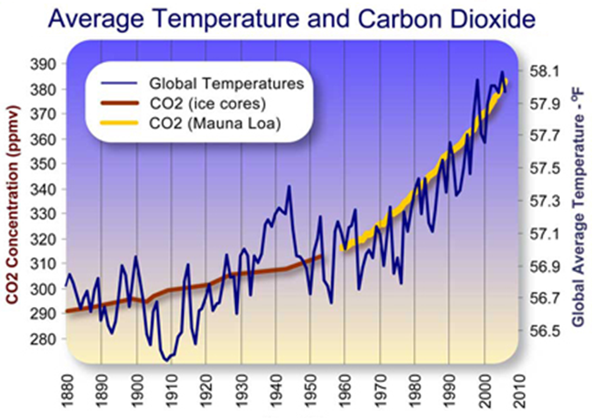
This is a big problem!
Notes:
Use brainstorming slide to help pupils answer the questions.

Slide 5
Then the temperature rose and fell again.
What does this graph tell us?
500 million years ago there was a sudden drop in temperature.
Then the same thing happened again.

Slide 6
Can you see why scientists worry about the climate getting warmer?

Slide 7
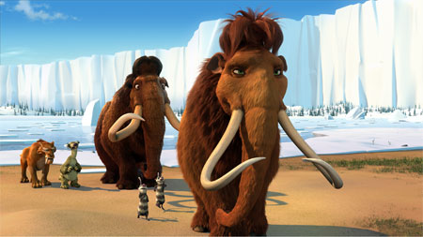
Are we heading for mass extinction and the next Ice Age?
What do you think?

Slide 8
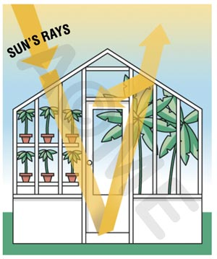
The Greenhouse Effect
carbon dioxide, carbon monoxide, methane, nitrous oxide, water vapour, CFCs
http://www.youtube.com/watch?v=dP-tg4atr5M

