Slide 1
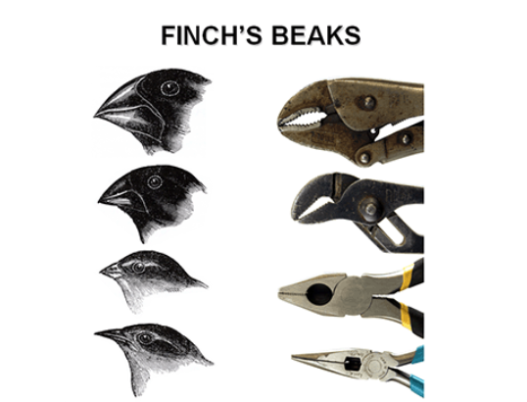
5.2 Natural selection
The image shows the changes of beak shape in the Galapagos finch to suit the different food sources available on different islands in the archipelago. Natural selection has caused one species to evolve into different, distinct species.
Essential idea: The diversity of life has evolved and continues to evolve by natural selection
By Chris Paine
https://bioknowledgy.weebly.com/
adapted from: http://online.itp.ucsb.edu/plecture/nurse/oh/27.jpg

Slide 2
Understandings, Applications and Skills
 | Statement | Guidance
5.2.U1 | Natural selection can only occur if there is variation among members of the same species.
5.2.U2 | Mutation, meiosis and sexual reproduction cause variation between individuals in a species.
5.2.U3 | Adaptations are characteristics that make an individual suited to its environment and way of life.
5.2.U4 | Species tend to produce more offspring than the environment can support.
5.2.U5 | Individuals that are better adapted tend to survive and produce more offspring while the less well adapted tend to die or produce fewer offspring.
5.2.U6 | Individuals that reproduce pass on characteristics to their offspring. | Students should be clear that characteristics acquired during the lifetime of an individual are not heritable. The term Lamarckism is not required.
5.2.U7 | Natural selection increases the frequency of characteristics that make individuals better adapted and decreases the frequency of other characteristics leading to changes within the species.
5.2.A1 | Changes in beaks of finches on Daphne Major.
5.2.A2 | Evolution of antibiotic resistance in bacteria.

Slide 3
Natural Selection Keywords
Adaptations | a feature of an organism that favours its survival to reproductive age. Adaptations can be behavioural, physiological, or structural.
Antibiotic | a chemical produced by microbes to kill off competing microbes.
Meiosis | reduction division involving the production of gametes.
Mutation | a change in DNA.
Natural selection | survival to reproductive age of the varieties that are best adapted to existing environmental conditions.
Selection pressure | an environmental variable that acts to remove poorly adapted individuals.
Sexual reproduction | reproduction involving the union of gametes.
Species | a naturally interbreeding group of organisms with similar morphology.
Variation | the range of phenotypes within a population.

Slide 4
http://www.aboutdarwin.com/timeline/time_01.html

Slide 5
5.2.U1 Natural selection can only occur if there is variation among members of the same species.
http://youtu.be/uz7U4k522Pg

Slide 6
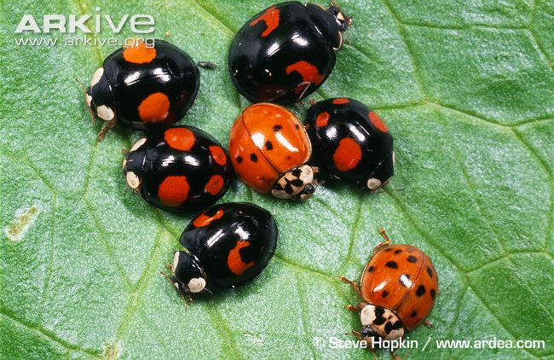
5.2.U1 Natural selection can only occur if there is variation among members of the same species.
The harlequin ladybird (Harmonia axyridis) is highly variable in appearance, with over 100 different colour forms reported worldwide.
The implication of variation is that some individuals will be more suited to particular conditions and hence more likely to survive.
http://www.arkive.org/harlequin-ladybird/harmonia-axyridis/image-G77560.html

Slide 7
5.2.U2 Mutation, meiosis and sexual reproduction cause variation between individuals in a species.

Slide 8
5.2.U2 Mutation, meiosis and sexual reproduction cause variation between individuals in a species.

Slide 9
5.2.U2 Mutation, meiosis and sexual reproduction cause variation between individuals in a species.

Slide 10
5.2.U2 Mutation, meiosis and sexual reproduction cause variation between individuals in a species.

Slide 11
5.2.U2 Mutation, meiosis and sexual reproduction cause variation between individuals in a species.

Slide 12
5.2.U2 Mutation, meiosis and sexual reproduction cause variation between individuals in a species.

Slide 13
5.2.U2 Mutation, meiosis and sexual reproduction cause variation between individuals in a species.

Slide 14
5.2.U2 Mutation, meiosis and sexual reproduction cause variation between individuals in a species.

Slide 15
5.2.U2 Mutation, meiosis and sexual reproduction cause variation between individuals in a species.

Slide 16
5.2.U3 Adaptations are characteristics that make an individual suited to its environment and way of life.

Slide 17
5.2.U3 Adaptations are characteristics that make an individual suited to its environment and way of life.

Slide 18
5.2.U3 Adaptations are characteristics that make an individual suited to its environment and way of life.
http://www.biologyinmotion.com/evol/index.html

Slide 19
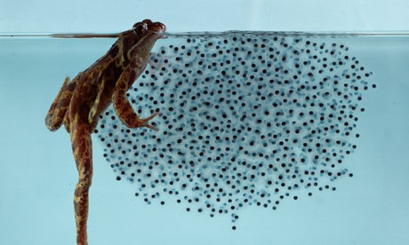
5.2.U4 Species tend to produce more offspring than the environment can support.
http://i.guim.co.uk/static/w-620/h--/q-95/sys-images/Guardian/Weather/WeatherWatch/2013/3/29/1364579451698/Female-Frog-and-Frogspawn-008.jpg

Slide 20
5.2.U5 Individuals that are better adapted tend to survive and produce more offspring while the less well adapted tend to die or produce fewer offspring.

Slide 21
5.2.U5 Individuals that are better adapted tend to survive and produce more offspring while the less well adapted tend to die or produce fewer offspring.

Slide 22
5.2.U5 Individuals that are better adapted tend to survive and produce more offspring while the less well adapted tend to die or produce fewer offspring.

Slide 23
5.2.U5 Individuals that are better adapted tend to survive and produce more offspring while the less well adapted tend to die or produce fewer offspring.

Slide 24
5.2.U5 Individuals that are better adapted tend to survive and produce more offspring while the less well adapted tend to die or produce fewer offspring.

Slide 25
5.2.U5 Individuals that are better adapted tend to survive and produce more offspring while the less well adapted tend to die or produce fewer offspring.

Slide 26
5.2.U5 Individuals that are better adapted tend to survive and produce more offspring while the less well adapted tend to die or produce fewer offspring.

Slide 27
5.2.U6 Individuals that reproduce pass on characteristics to their offspring.
Allele frequency
changes

Slide 28
5.2.U6 Individuals that reproduce pass on characteristics to their offspring.
n.b. only heritable characteristics, those with a genetic basis, can be passed on to offspring. Children can inherit the skin tone of their parents, but tanned skin cannot be passed on.
Allele frequency
changes

Slide 29
5.2.U7 Natural selection increases the frequency of characteristics that make individuals better adapted and decreases the frequency of other characteristics leading to changes within the species.
Alleles* that encode for well adapted characteristics increase in frequency whilst those that encode for ill adapted characteristics decrease.
Allele frequency
changes
*Alleles are differing forms of a gene

Slide 30
5.2.U7 Natural selection increases the frequency of characteristics that make individuals better adapted and decreases the frequency of other characteristics leading to changes within the species.
Allele frequency
changes

Slide 31
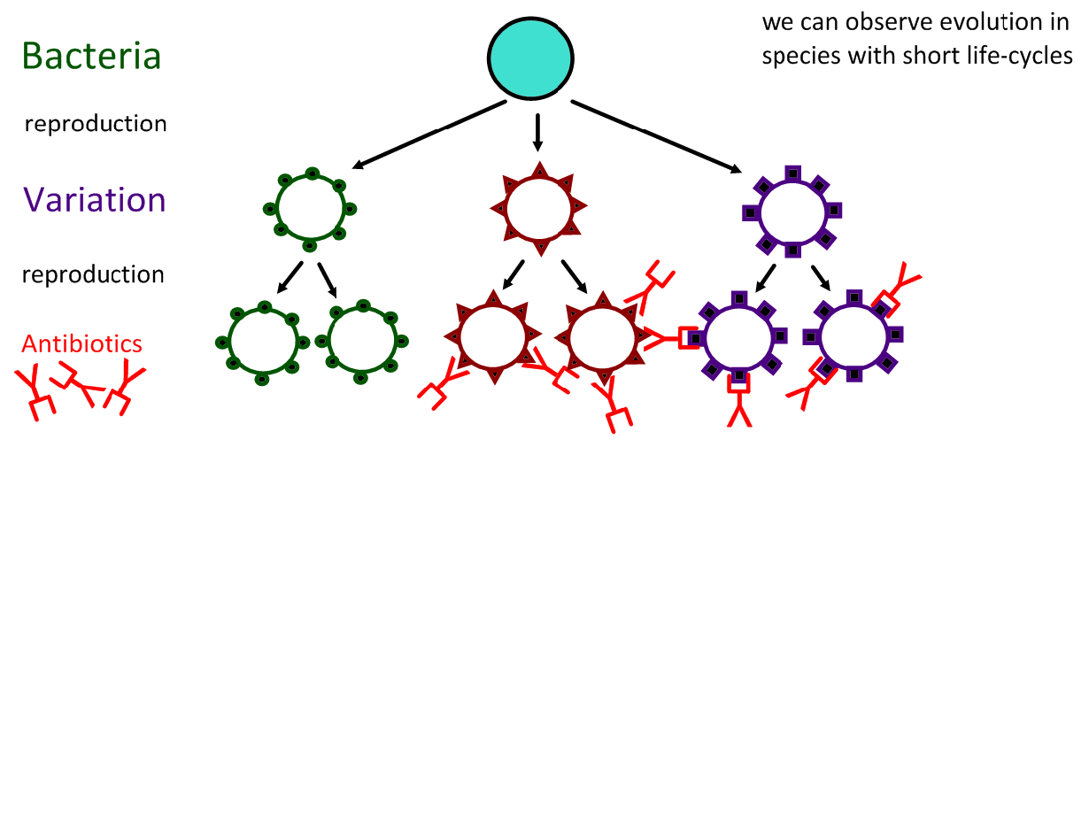
5.2.A2 Evolution of antibiotic resistance in bacteria.

Slide 32
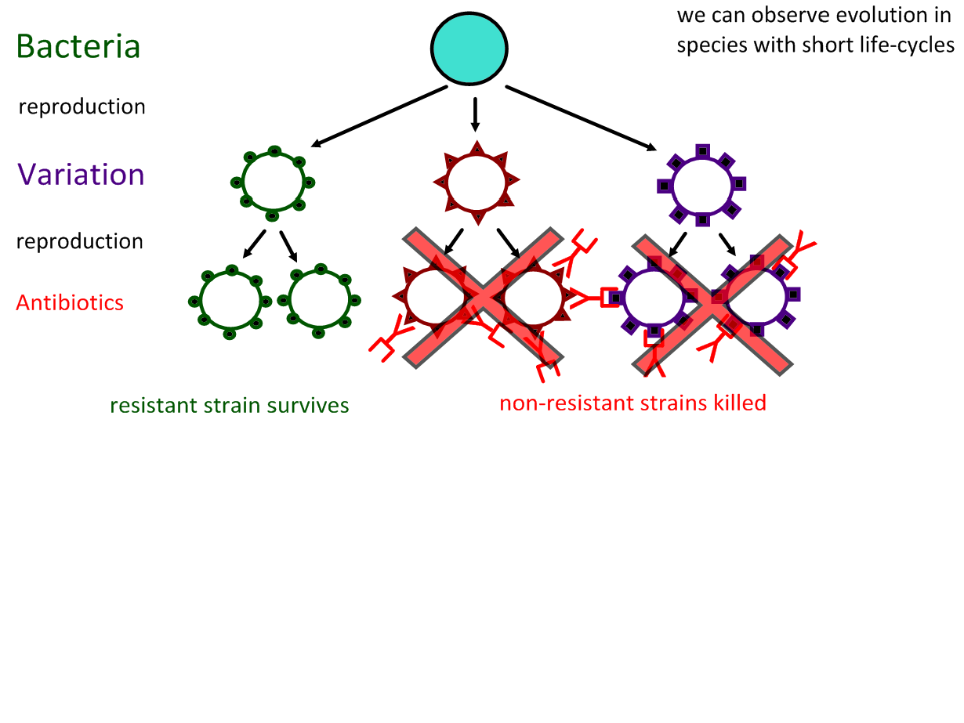
5.2.A2 Evolution of antibiotic resistance in bacteria.

Slide 33
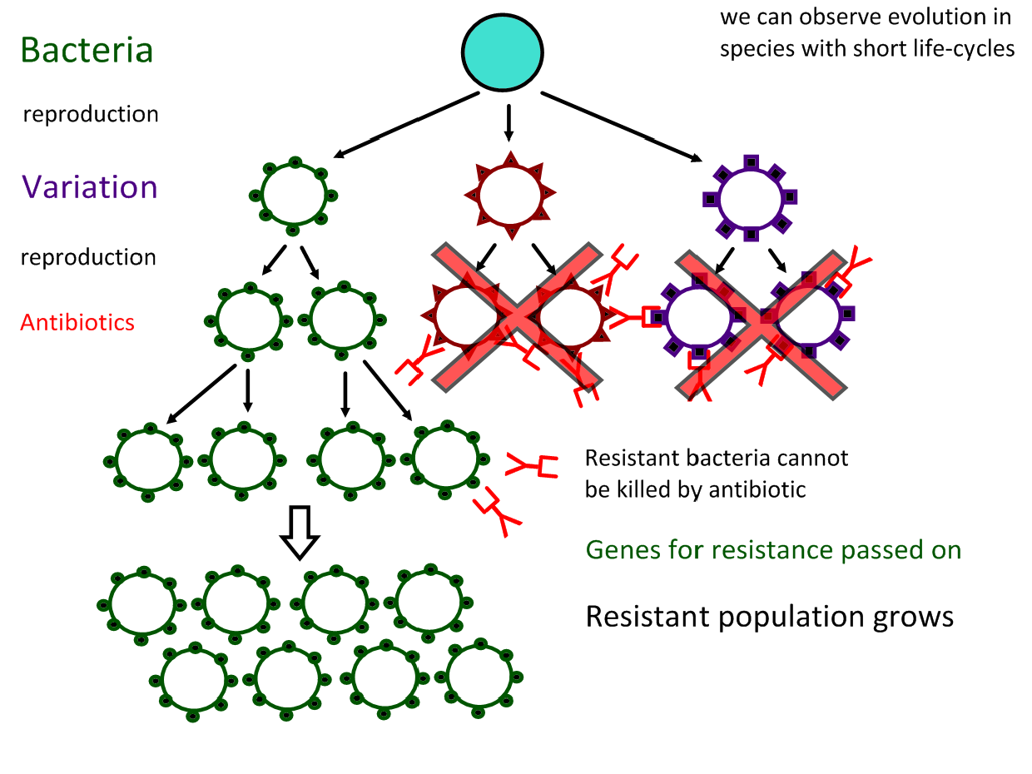
5.2.A2 Evolution of antibiotic resistance in bacteria.

Slide 34
5.2.A2 Evolution of antibiotic resistance in bacteria.
http://www.sumanasinc.com/scienceinfocus/antibiotics/antibiotics_fla.html

Slide 35
http://www.sepa.duq.edu/finches.html
Useful background information to (Darwin’s) Galapagos ground finches
http://www.pbs.org/wgbh/evolution/darwin/origin/index.html
http://mrhardy.wikispaces.com/Natural+Selection.swf

Slide 36
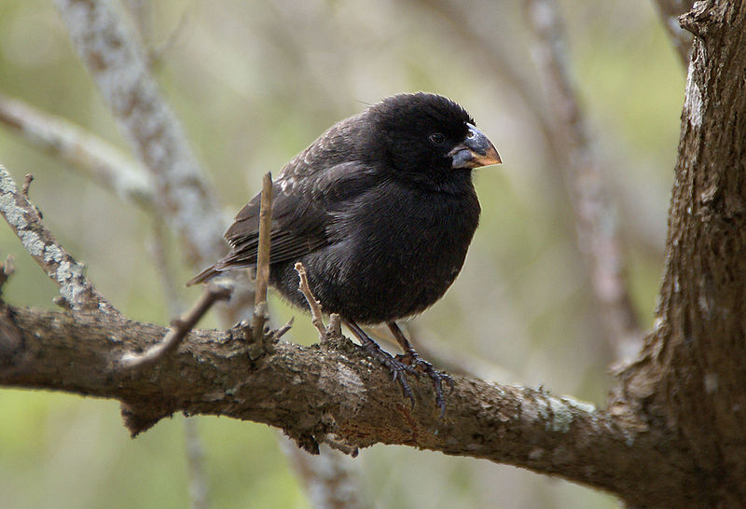
5.2.A1 Changes in beaks of finches on Daphne Major.
Medium ground finch : Evolution in action
Beak shape and size in Geospiza fortis
Variation: there is a different in the size and shape of beaks
endemic to the Galapagos Islands
habitats are arid lowland forests and shrubland.
generally feeds on seeds, but will also feed on insects and the fruit of cacti.
http://commons.wikimedia.org/wiki/File:Geospiza_fortis.jpg

Slide 37
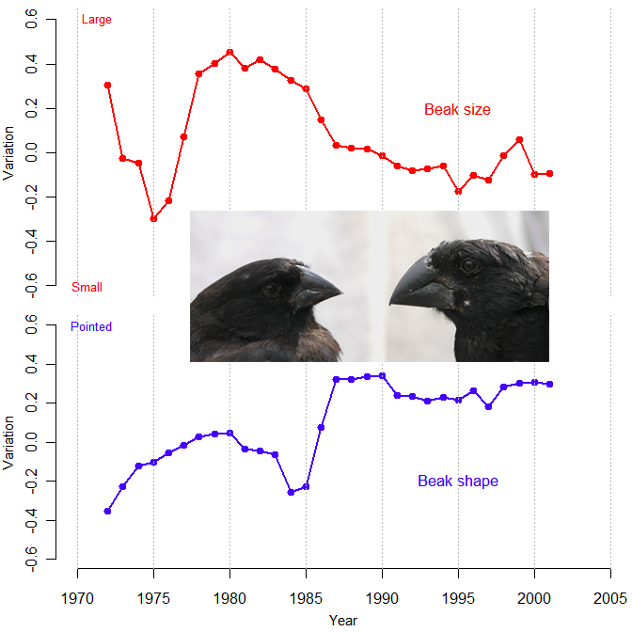
5.2.A1 Changes in beaks of finches on Daphne Major.
Medium ground finch : Evolution in action
Beak shape and size in Geospiza fortis
Variation: there is a different in the size and shape of beaks
1st Environmental change:
1974 to 1977 drought (La Niña) conditions were experienced on Daphne Major as a consequence there was a shortage in smaller sized seeds
2nd Environmental change:
1983 heavy and frequent rains (El Niño event) were experienced on Daphne Major as a consequence there was an abundance of smaller sized seeds
Deduce the results from the graphs
https://coreybradshaw.files.wordpress.com/2011/02/figure1.jpg
http://commons.wikimedia.org/wiki/File:Geospiza_fortis.jpg

Slide 38
5.2.A1 Changes in beaks of finches on Daphne Major.
Medium ground finch : Evolution in action
Beak shape and size in Geospiza fortis
Variation: there is a different in the size and shape of beaks
1st Environmental change:
1974 to 1977 drought (La Niña) conditions were experienced on Daphne Major as a consequence there was a shortage in smaller sized seeds
Result:
the population of finches declined dramatically
The mean beak size of surviving finches was higher than before the drought
The mean beak size remained high in successive generations
2nd Environmental change:
1983 heavy and frequent rains (El Niño event) were experienced on Daphne Major as a consequence there was an abundance of smaller sized seeds
Result:
Over successive generations the mean beak size decreased
https://coreybradshaw.files.wordpress.com/2011/02/figure1.jpg
http://commons.wikimedia.org/wiki/File:Geospiza_fortis.jpg

Slide 39
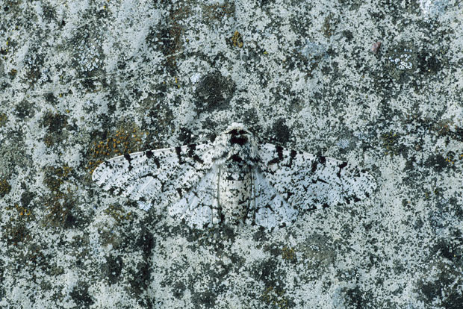
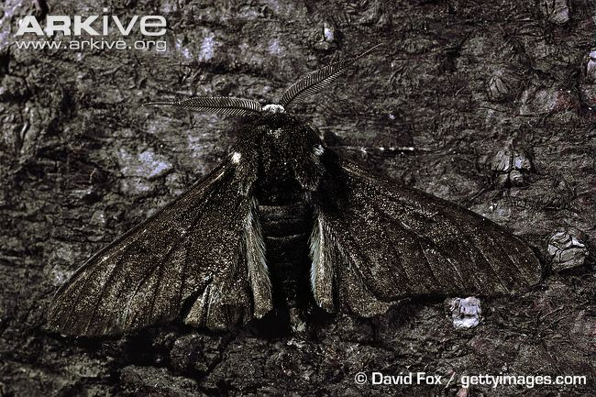
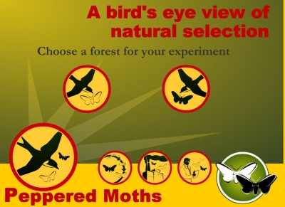
5.1.A1 Development of melanistic insects in polluted areas.
Variation: Peppered moths (Biston betularia) moths are found in two forms:
The dark form (carbonaria) is normally very rare.
Use the animation to find out about evolution in Peppered moths
Normal environment: In unpolluted areas tree branches are covered in pale coloured
lichens camouflage for the paler form (insularia).
Environmental change: sulphur dioxide pollution kills the lichens and soot (from coal burning) blackens the tree branches.
The moths fly at night to try to find a mate, but, during the day they rest on the branches of trees.
Result: the dark moths are well camouflaged from birds against dark tree branches are many survive to reproduce, but light coloured moths are easily found and predated by birds, few survive to reproduce.
Selective pressure: Predation from birds (and other animals) whilst resting
http://peppermoths.weebly.com/
Evolution: over a number of generations the dark (carbonaria) form of the peppered moth has increased with frequency - the heritable characteristics of the population have changed.
http://i.telegraph.co.uk/multimedia/archive/02077/peppered-moth_2077529i.jpg

Slide 40
5.1.A1 Development of melanistic insects in polluted areas.
Variation: Peppered moths (Biston betularia) moths are found in two forms:
The dark form (carbonaria) is normally very rare.
Normal environment: In unpolluted areas tree branches are covered in pale coloured
lichens camouflage for the paler form (insularia).
Environmental change: sulphur dioxide pollution kills the lichens and soot (from coal burning) blackens the tree branches.
The moths fly at night to try to find a mate, but, during the day they rest on the branches of trees.
Result: the dark moths are well camouflaged from birds against dark tree branches are many survive to reproduce, but light coloured moths are easily found and predated by birds, few survive to reproduce.
Selective pressure: Predation from birds (and other animals) whilst resting
Evolution: over a number of generations the dark (carbonaria) form of the peppered moth has increased with frequency - the heritable characteristics of the population have changed.
http://i.telegraph.co.uk/multimedia/archive/02077/peppered-moth_2077529i.jpg

Slide 41
5.1.A1 Development of melanistic insects in polluted areas.
Variation: Peppered moths (Biston betularia) moths are found in two forms:
The dark form (carbonaria) is normally very rare.
Normal environment: In unpolluted areas tree branches are covered in pale coloured
lichens camouflage for the paler form (insularia).
n.b. Environmental policies in Europe have reduced air pollution and evolution of the peppered moth is now reversing.
Environmental change: sulphur dioxide pollution kills the lichens and soot (from coal burning) blackens the tree branches.
The moths fly at night to try to find a mate, but, during the day they rest on the branches of trees.
Result: the dark moths are well camouflaged from birds against dark tree branches are many survive to reproduce, but light coloured moths are easily found and predated by birds, few survive to reproduce.
Selective pressure: Predation from birds (and other animals) whilst resting
Evolution: over a number of generations the dark (carbonaria) form of the peppered moth has increased with frequency - the heritable characteristics of the population have changed.
http://i.telegraph.co.uk/multimedia/archive/02077/peppered-moth_2077529i.jpg

Slide 42
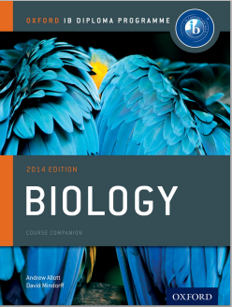
Bibliography / Acknowledgments
Jason de Nys

