Slide 1
Succession FlipTask
Your task is to learn the basics of succession and its key terminology BEFORE our lesson on it.
You may take whatever notes you need from the videos/powerpoint to bring in to lesson.
HINT: Keywords are very important in this topic and should be clearly defined wherever possible!

Slide 2
Succession Videos
QUICK INTRO:
https://www.youtube.com/watch?v=9kkWxUgMHfA
CRASH COURSE:
https://www.youtube.com/watch?v=jZKIHe2LDP8
BOZEMAN:
https://www.youtube.com/watch?v=V49IovRSJDs

Slide 3
Succession Animation
http://www.kscience.co.uk/as/module5/succession/index.htm

Slide 4
Objectives
14. Define succession as the change in structure and species composition of a community over time.
15. Describe primary succession refers to the introduction of plants/ animals into areas that have not previously been colonised whereas secondary succession refers to the reintroduction of organisms into a bare habitat previously occupied by plant and animals
16. State that the stages in a succession when particular communities dominate are known as seres.
17. Describe succession as changes in community structure and function until a community reaches a climax of succession known as the climax community.
18. Explain the changes which take place in succession from bare rock to grassland to scrub to woodland, understanding that species diversity increases as does the stability of the community.

Slide 5
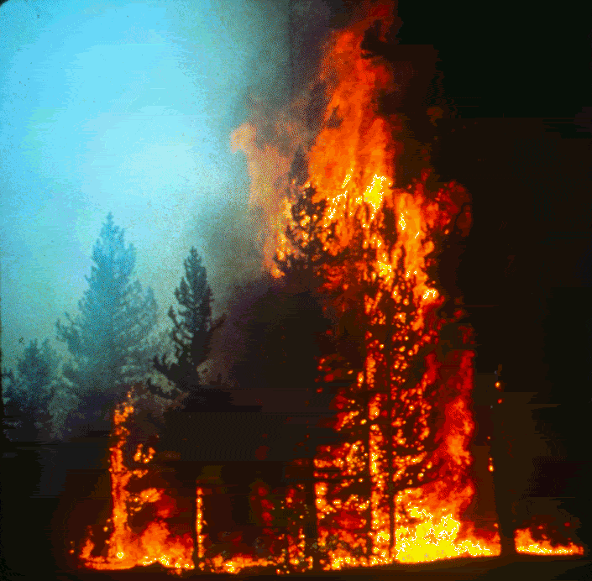
Succession –
is the gradual directional change of a community over time’

Slide 6

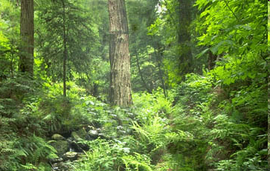
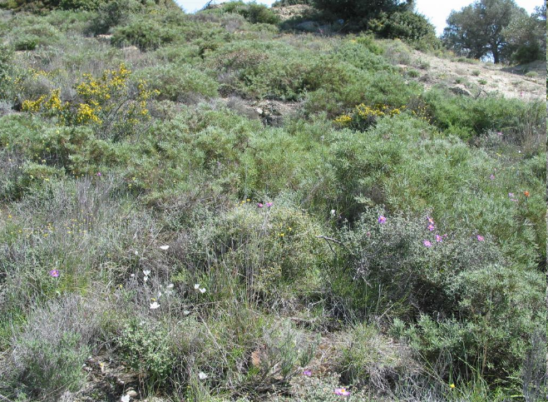
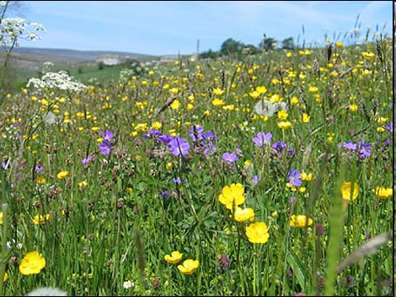
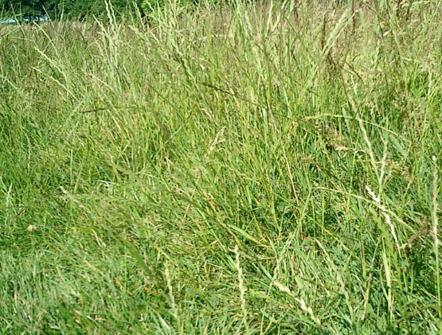
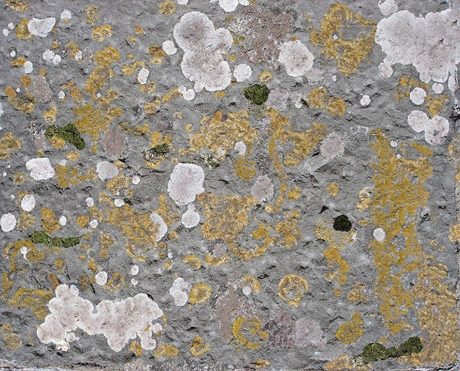
What if this process is disturbed?
Trees
Shrubs
Herbaceous Plants
Grass
Lichen & Moss
Secondary Succession
Bare Rock
A rapid process

Slide 7
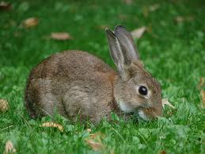
What if succession remains arrested by continuous disturbance?
Herbaceous Plants
Grass
Lichen & Moss
Plagioclimax
Bare Rock
eg. grazing

Slide 8
Each of these steps are known as seral stages
Identifiable stage in succession
Trees
Sere = the series of changes in succession
Shrubs
Herbaceous Plants
Grass
In what other environments could seres develop?
Lichen & Moss
Bare Rock

Slide 9
There are two types of succession:
Primary succession
Secondary succession
Here a community is damaged and the soil is left plants then colonise
(e.g. a woodland has been felled).
the starting point is bare ground e.g. rock
The END POINT of both types of succession is the climax community

Slide 10
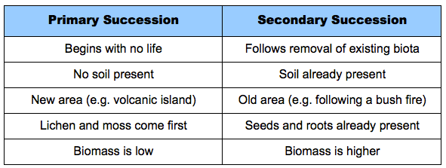

Slide 11
Succession on sand dunes
Nearest the sea, only a few species
can colonise the sand.
Why?

Slide 12
Succession on sand dunes
Nearest the sea, only a few species
can colonise the sand.
Sand constantly moves

Slide 13
Succession on sand dunes
Nearest the sea, only a few species
can colonise the sand. Why?
Sand constantly moves
High salt concentration

Slide 14
Succession on sand dunes
Nearest the sea, only a few species
can colonise the sand. Why?
Sand constantly moves
High salt concentration
freely draining ‘soil’

Slide 15
Succession on sand dunes
Nearest the sea, only a few species
can colonise the sand. Why?
Sand constantly moves
What types of factors are these?
High salt concentration
freely draining ‘soil’

Slide 16
Succession on sand dunes
In the earliest stages succession in limited by abiotic factors

Slide 17
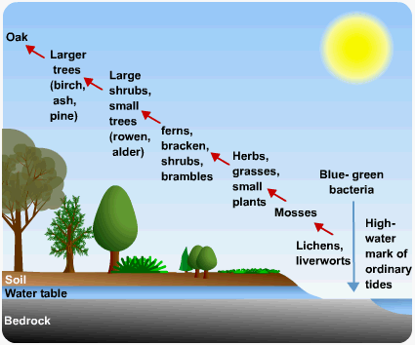

Slide 18
Succession on sand dunes
Very specialised species live in this area, they are called PIONEERS
These species are show xeromorphic & halophytic characteristics
Sea rocket (Cakile maritima)
Sea holly (Eryngium maritimum)

Slide 19
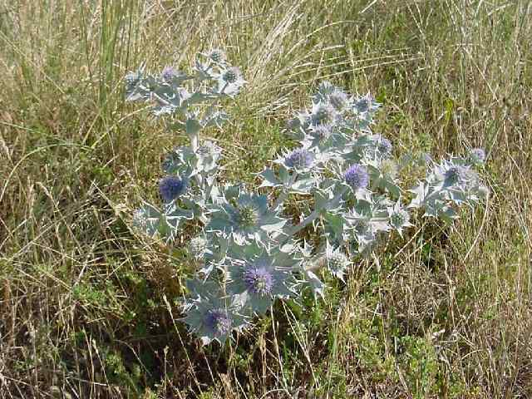
Sea holly…………..
……………… pioneer species
………of sand dunes

Slide 20
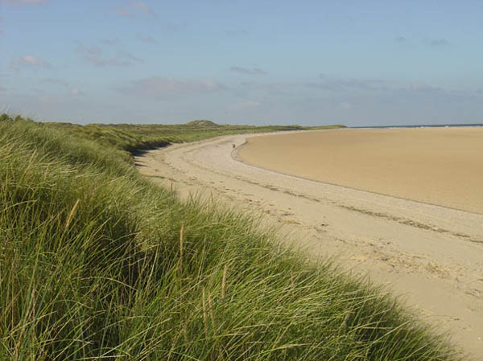

Slide 21
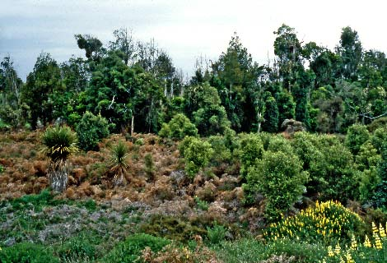

Slide 22
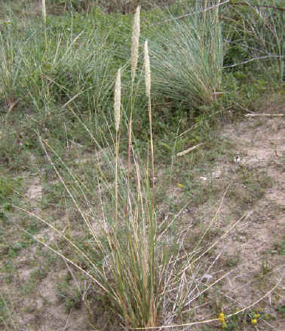
Marram grass
Marram Grass stabilizes the sand some distance below the surface because of its deep vertical root system and extensive horizontal root network.
The clumps of Marram Grass are continually buried, only to regrow up through the newly deposited sand.

Slide 23
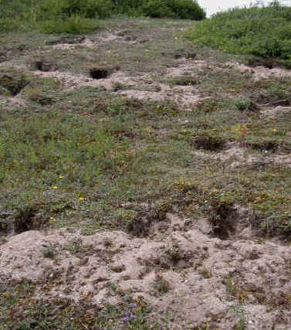
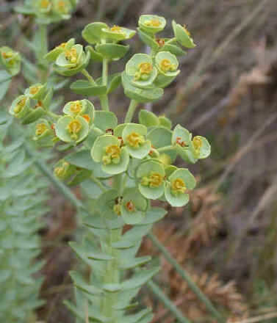
Spurges will colonize the hotter, drier slopes of the dunes. They have fleshy, waxy leaves with a high capacity for water storage.

Slide 24
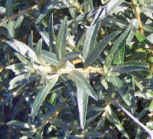
Sea buckthorn

Slide 25
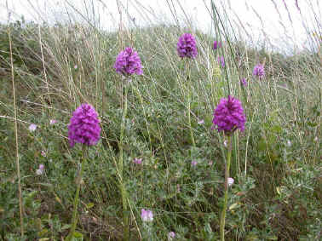
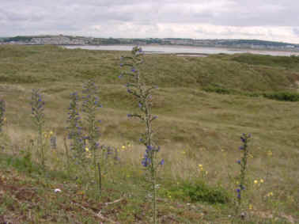
The dunes by now have a more or less continuous plant cover, effectively anchoring the dune sand in one place so there is now a ‘soil’ for further plants to colonise
Pyramidal Orchid

Slide 26
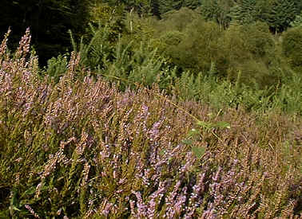
What other factors might now be limiting the heather?
Heather

Slide 27
Outline the changes in species diversity and production during primary succession
Species diversity will increase as primary succession proceeds
  Only a few species (lichen and moss) are capable of living in environments that have never sustained life before (pioneer species)
  As these species alter the environment, it becomes more habitable, leading to a larger diversity of species colonising the region
Production – an increase in biomass or available energy – will also increase as primary succession proceeds
  In early succession, there are few plants, so gross production and net production are low
  As the number and density of plant species increases with more soil, productivity also becomes greater

Slide 28
Explain the effects of living organisms on the abiotic environment, with reference to the changes occurring during primary succession
Primary succession begins on new land, with pioneer species breaking down substrate to create organic soil
As plant species colonise the area, the litter produced by their growth and their decomposing remains will cause the following changes:
  Will increase soil depth (adds humus to soil)
  Will increase soil mineral content (and break down rock through root growth)
  Will aerate soil and alter the soil pH
  Will improve soil water retention and reduce draining
This will allow for the growth of larger plants, which will provide shade and reduce erosion through the binding action of their roots

Slide 29
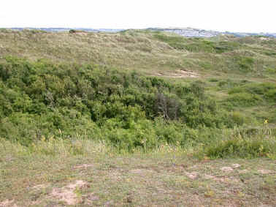
Bushes will develop on the tops and in the hollows of the dunes. These will include species such as
Hawthorn, Elder, Brambles

Slide 30
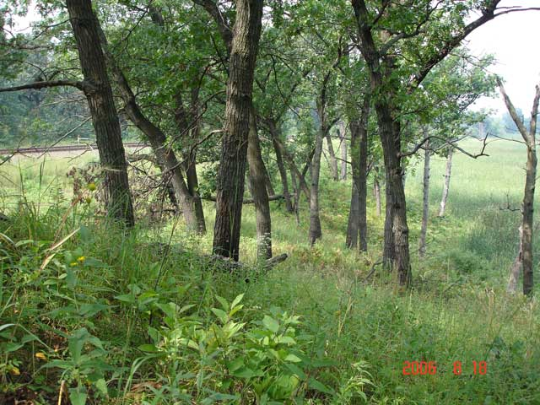
Climax community
Biotic competition is now an important factor within and between species

